Slide 1
Project Shining
Zoe Rowbotham, Ryan Manning, Liam David, Liam Neale, Ryan Freeman

Slide 2
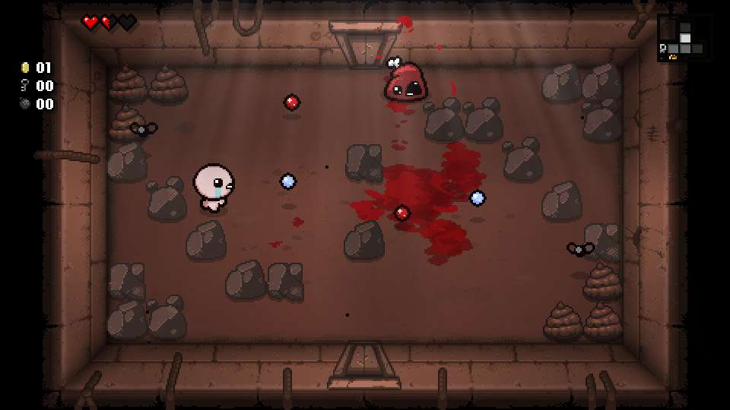
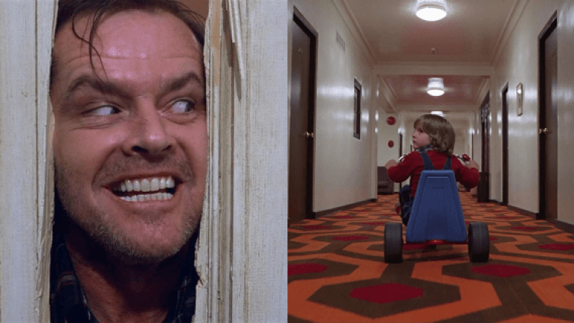
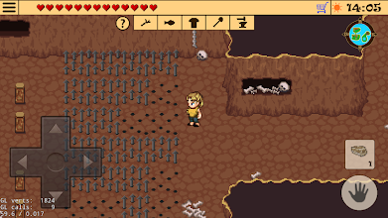
Game Overview
Top-down 2d adventure game
Play as a boy running from an evil axe
your goal to escape the house by completing all the floors
Each floor will have a different reality which means different enemies
Utilise the items in the game to survive e.g. health up, damage up, speed up

Slide 3
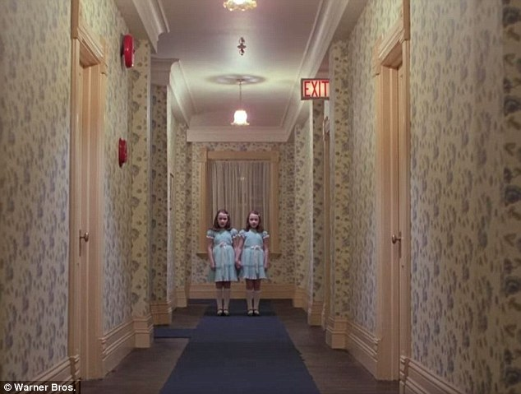
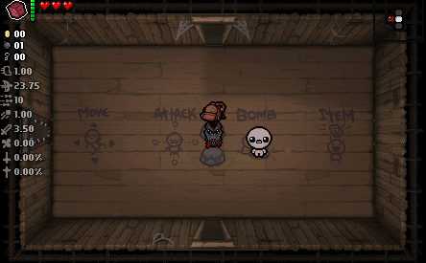
Map Layout
Random room generation
A set of specific rooms to pick from
Different designs from past and present
Features:
Collectible items
Secret passages, items etc
Enemies
Spooky things like moving doors, triggered by movement and ghosts
Can see room and exits
Similar to Binding of Isaac

Slide 4
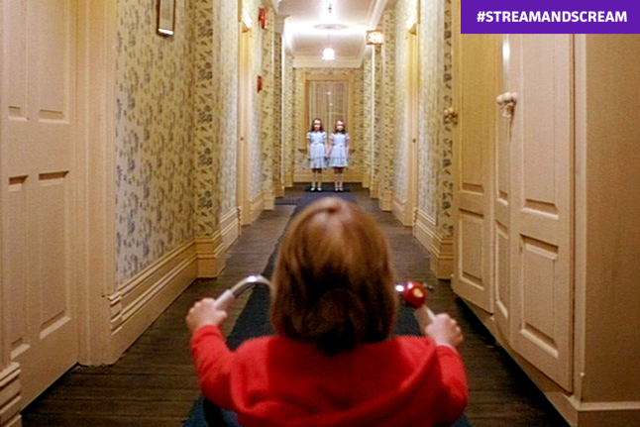
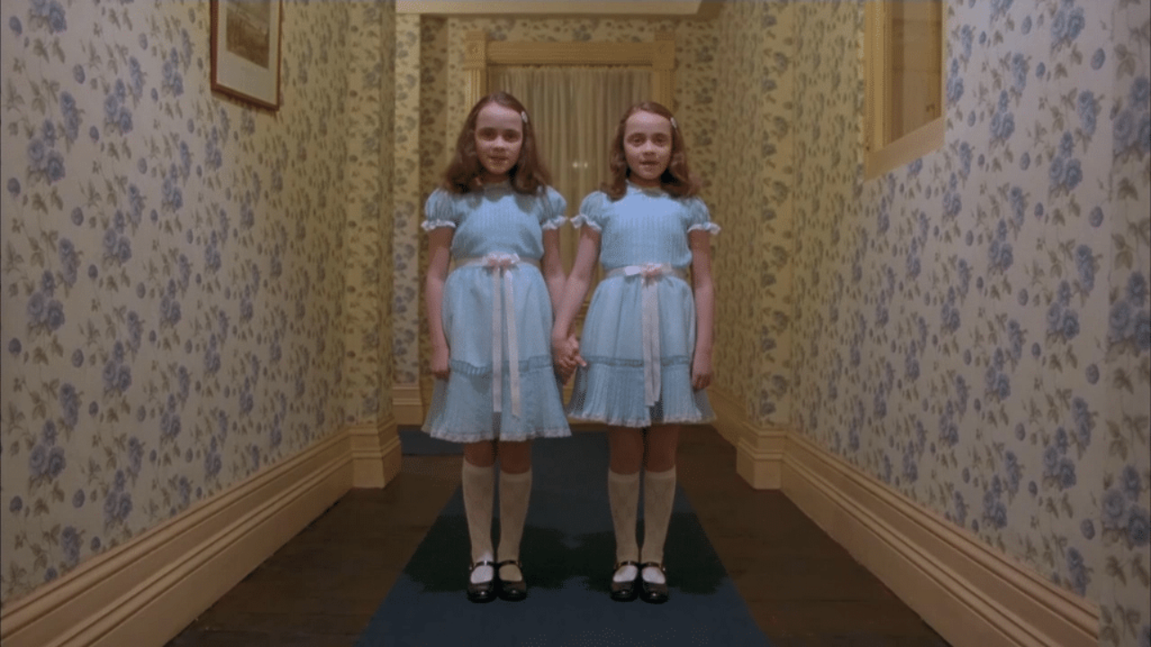
The Player
You are a boy trying to escape the hotel and get away from the psycho killer axe man!
Using WASD you will navigate around the hotel
There will be a number of power ups the player can pick up throughout, including HP up, power up, speed up
You have the shine so you can see various scary enemies!
Using the spacebar, you can throw objects at the enemies to kill them!

Slide 5

Enemies
There will be a number of enemies which will attempt to stop you throughout the game
Some levels will contain different variants of a select number of standard enemies
These enemies are;
The axe wielding psycho!
He will follow you between levels trying to attack you
The demons!
Demons will throw items within each room at you, keeping their distance
The Poltergeists
Ghosts will possess various objects around you, potentially blocking your path

Slide 6

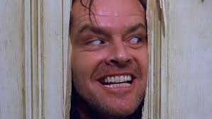
Links to The Shining
Different Versions of reality in different rooms
Inspiration taken from the theme present in the film
Enemies based from the film
Inspiration taken from the different threats in the film
The rooms will be based off the hotel
Inspiration taken from the hotel in the film
There will be puzzles in the game
Inspiration for these will be based from the film(Hedge Maze)

Slide 7
Questions?

